Slide 1



Mid-Term Presentation
Marketing Strategy for AstrallyTech
Presented by
Guided by
Team TechSurfers
Lalit Madhav Viyyapu - lxv230008
Gampa Sai Shiva - sxg220333
Jiapeng Cao - jxc180070
Subramanian Ramesh Akshay - axs230128
Grandhi Sai Snehal - sxg230071
Mr. Dhimant Korant
Co-Founder & CEO
AstrallyTech

Slide 2
Brand Introduction
Astrally is a tech consulting firm specializing in data migration, analytics, and SMS marketing. We help businesses leverage cloud technologies and data-driven strategies to boost performance and scale effectively.
With tailored solutions and a focus on innovation, Astrally supports startups and SMBs in driving digital transformation through:
💾 Seamless data migration
📊 Actionable analytics
📱 Engaging SMS marketing campaigns
Main goal: to deliver smart, scalable solutions that grow with your business.

Slide 3
Main
Vertical
Data Migration
SMS Marketing
Analytics
Seamlessly transferring data to new systems, ensuring accuracy and efficiency
Providing in-depth data analysis to drive informed decision-making and business intelligence
Delivering effective SMS marketing campaigns to enhance customer engagement and reach

Slide 4

Market
Industry Trends
Research
Growing demand for IT consulting in data management and infrastructure due to digital transformation (Gartner, 2023).
Rapid expansion of cloud computing and cybersecurity solutions (Statista, 2023).
Rising demand for remote work, contract staffing, and AI-driven recruitment (IBISWorld, 2023).
Increased adoption of project management tools and SMS marketing solutions (G2, 2023).
AI and automation are reshaping IT services and staffing (Forbes, 2023)

Slide 5

Market
Customer Behaviour
Research
Enterprises prioritize data-driven decision-making, boosting demand for advanced IT consulting (Crunchbase, 2023).
Businesses seek scalable, cost-effective staffing solutions (Clutch, 2023).
SMBs and enterprises adopt integrated project management tools for efficiency (Goodfirms, 2023).
AI-powered recruitment platforms enhance hiring efficiency (TechCrunch, 2023).
Mobile-based marketing growth drives demand for SMS marketing solutions (Business Insider, 2023).

Slide 6
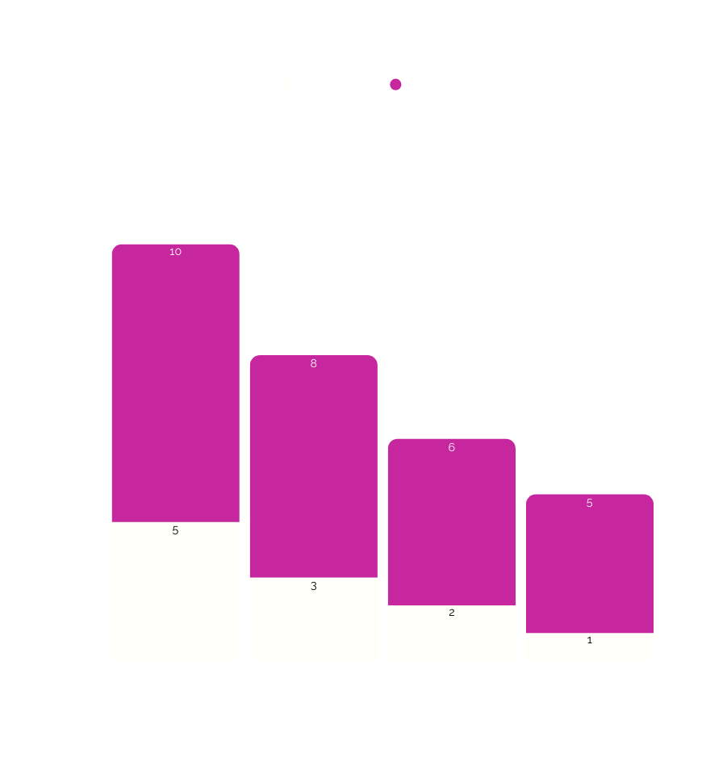
Competitor
Analysis
Revenue Insights
TechNova Solutions (2023): Estimated $5-10 million (Owler, 2023).​
HireTech Hub (2023): Estimated $3-8 million (ZoomInfo, 2023).​
TaskFlow Apps (2023): Estimated $2-6 million (G2, 2023).​
SMS Connect Pro (2023): Estimated $1-5 million (Clutch, 2023).

Slide 7
SWOT
Analysis
Factor | Strengths | Weaknesses | Opportunities | Threats
TechNova Solutions | Personalized service, niche expertise | Limited brand recognition | Growing demand for specialized IT consulting | Larger firms offering competitive pricing (ZoomInfo, 2023)
HireTech Hub | Specialized tech staffing, quick hiring process | Limited global reach | Expansion in remote and contract-based hiring | High competition from other small agencies (Crunchbase, 2023)
TaskFlow Apps | Affordable, user-friendly project management tools | Fewer advanced features | Increasing adoption by startups & SMBs | Competition from freemium tools (G2, 2023)
SMS Connect Pro | Cost-effective, easy-to-use platform | Limited enterprise features | Growing demand for SMS marketing​ | Compliance and regulatory challenges (Business Insider, 2023)

Slide 8

Primary Target Audience​
Target
Startups & SMBs in need of IT consulting for data management &IT infrastructure.​
HR & Hiring Managers seeking technology staffing solutions.​
Project Managers & Small Business Owners requiring project management tools.​
Local Businesses & SMEs looking for SMS marketing solutions.
Audience

Slide 9

Customer
Personas
Startup Founder (SMB & Enterprise Clients)
Pain Points: Limited IT resources, cost-effective solutions needed.
Solution: IT consulting for data management & infrastructure.
Channels: LinkedIn, industry events, startup forums (Gartner, 2023).
HR Manager (Tech Staffing Clients)
Pain Points: Difficulty finding specialized talent, long hiring cycles.
Solution: AI-powered staffing, contract & full-time tech hiring.
Channels: Job portals, LinkedIn, HR networking events (Clutch, 2023).
Startup Project Manager (Tech Product Users)
Pain Points: Need simple, affordable project management tools.
Solution: Cost-effective project management apps.
Channels: Software review platforms, LinkedIn ads, startup incubators (G2, 2023).
Local Business Owner (SMS Marketing Clients)
Pain Points: Low customer engagement, poor marketing ROI.
Solution: Automated SMS marketing for small businesses.
Channels: Local business groups, digital marketing blogs, email campaigns (Business Insider, 2023).
Next Slide

Slide 10
Unique value proposititon
End-to-End Integration: Seamless IT, marketing & data solutions​
💡 Innovation-Driven: Cutting-edge technology implementation​
📈 Scalable Solutions: Growth-aligned technology​
🎯 Industry Focused: Deep vertical expertise​
🤝 Partnership Approach: Long-term client success​
Business
Strategy Developement
Brand positioning
🏢 Target Market: SMB and mid-market enterprises​
💪 Market Position: Premium full-service technology partner​
🎯 Core Focus: Digital transformation enabler​
🌐 Coverage: Multi-industry expertise​
✨ Differentiation: Integrated solutions provider(personalised custormer relationship)​

Slide 11
Phase 1: Foundation (Jun-Dec 2025)
​
🚀 Launch core services: Start with most in-demand services​
🌐 Establish digital presence: Website, social media, content strategy​
👥 Build initial sales team: Industry-specialized account executives​
🤝 Develop partner network: Technology vendors and serviceproviders
Go-to Market
Strategy
Phase 2: Growth (Jan-Jun 2026)​
📈 Scale service portfolio: Add specialized offerings​
📣 Expand marketing operations: Content marketing and thoughtleadership​
⚡ Enhance delivery capabilities: Standardize processes forefficiency​
❤️ Launch client success program: Proactive support andoptimization
Phase 3: Scale (Jun 2026- ∞)
​
🌍 Geographic expansion: Move into new regions​
🎯 New vertical penetration: Expand industry focus​
💡 Advanced solution development: Develop proprietary tools​
🤝 Strategic partnerships: Strategic alliances for growth

Slide 12
Industry focus​
📈 Growth-stage businesses (10-100 employees): Focus on fundamentaldigital transformation​
🏢 Mid-market companies (100-500 employees): Complex integrationand scaling solutions
Target Segments​
Key Verticals: (Each chosen for growth potential and technology needs)​
📈 Scale service portfolio: Add specialized offerings​
📣 Expand marketing operations: Content marketing and thoughtleadership​
⚡ Enhance delivery capabilities: Standardize processes forefficiency​
❤️ Launch client success program: Proactive support andoptimization

Slide 13

📊 IT Consulting: 40%
​​
Enterprise architecture planning​
Cloud migration services​
Security implementations​
Digital transformation projects Why This Mix? Highest valueservice with strong market demand and established pricingmodels​
💰 Revenue Model
📱 SMS Marketing: 30%
Campaign management​
Automation solutions​
Analytics & reporting​
Customer engagement Why This Mix? Growing market withrecurring revenue potential and scalable delivery model
📈 Data Analytics: 30%​
Business intelligence​
Predictive analytics​
Data visualization​
Custom reporting Why This Mix? High-growth area with strongupsell potential and strategic value

Slide 14
🏗️ Project-Based (35% of Revenue)
💰 Pricing Strategy​
Range: $20K-$100K per project​
Timeline: 2-6 months​
Best for: Large implementations, migrations, transformations WhyThis Model? Allows for high-value, complex deliverables with clearscope and milestones
🔄 Retainer-Based (50% of Revenue)
Monthly Fee: $3K-$15K​
Contract Length: 12-36 months​
Best for: Ongoing support, maintenance, and continuous improvement Why This Model? Provides stable, predictable revenue stream and deeper client relationships
⭐ Performance-Based (15% of Revenue)
Structure: Base fee + performance incentives​
Focus: Marketing and analytics services​
Best for: Results-driven campaigns and optimization projects WhyThis Model? Aligns interests with clients and demonstratesconfidence in service quality

Slide 15


Platform Selection
Social Media Advertising​
Select the platform that is popular with high user amount
Select the platform that is related to the service of the company
Implementation
Run YouTube ads showcasing Astrally’s services and success stories.​
Use banner ads on tech-focused platforms (e.g., TechCrunch, Clutch, and G2).

Slide 16


Search Engine Marketing (SEM)
Google Ads
Target keywords related to IT consulting, tech staffing, and business project management tools.​
Run PPC (pay-per-click) campaigns optimized for conversions and lead generation.​
Social Media Advertising​
Social Media Advertising​
Use Facebook, Instagram, and LinkedIn ads to promote case studies and webinars.​
Implement retargeting campaigns to capture leads who engaged with website content.

Slide 17

Budget
Plan
General marketing budget allocation
SMBs allocate 7-8% of annual revenue to marketing.
B2C companies may spend between 5-10%, or up to 15%, while B2B firms allocate around 5%.
Monthly Marketing Spend:
Small to mid-sized businesses invest between $2,500 and $12,000 in digital marketing (WebFX).
​
This budget includes SEO, paid advertising (PPC), social media, email marketing, and content creation.

Slide 18
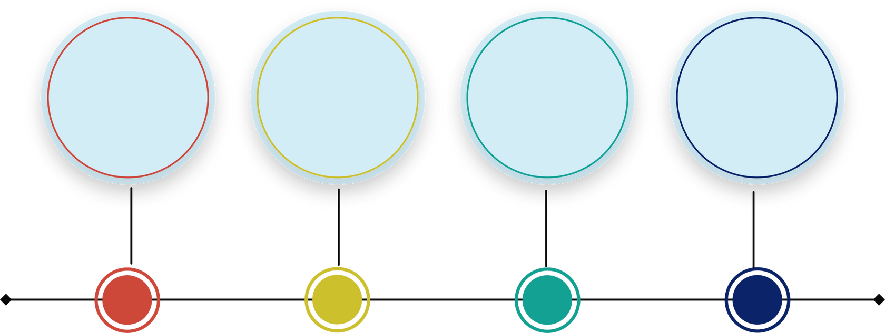
Implementation Roadmap​
Launch
and
Awareness
(Jun - Aug
2025)
Lead
Generation
& Engagement
(Aug
– Oct 2025)
Expansion & Optimization (Oct –
Dec 2025)
Scaling & Market Leadership
(Dec 2025 –
Feb 2026)
Finalize brand positioning
Launch SEO website
Set up LinkedIn, Twitter, YouTube
Start content strategy
Run Google & LinkedIn Ads
Run email marketing
Start drip campaigns
Partner with influencers
Conduct webinars
Monitor & optimize ads
Scale content marketing
Optimize PPC & SEM
Strengthen referral programs
Launch retargeting ads
Boost social media interactivity
Use advanced analytics
Target new industries
Create industry reports
Gather customer feedback
Plan 2026 strategy

Slide 19
Marketing Automation & CRM
HubSpot – Lead management, email marketing, and customer tracking.​
Marketo – Advanced B2B marketing automation.​
Zoho CRM – Affordable CRM with automation features.
Social Media & Advertising​
Recommended Tools & Platforms​
LinkedIn Ads & Campaign Manager – Target B2B decision-makers.​
Google Ads & SEMRush – PPC and search engine marketing.​
Hootsuite / Buffer – Social media scheduling and automation.
Analytics & SEO Optimization
Google Analytics & Search Console – Website traffic and SEOtracking.​
SEMRush / Ahrefs – Keyword research and competitor analysis.​
Hotjar – User behavior analytics for website performance.​

Slide 20
Roles & Responsibilities
for Marketing Execution​
Marketing Manager
Content Strategist
Marketing Analyst
Oversee overall marketing strategy and execution.​
Coordinate teams and ensure timely implementation.
Develop and manage content strategy including blogs, case studies,and reports.​
Optimize content for SEO and lead generation.
Track campaign performance using analytics tools.​
Provide insights for continuous strategy adjustments.
Social Media Manager
Paid Advertising Specialist
Partnership Manager​
Manage engagement on LinkedIn, Twitter, and YouTube.​
Execute social media advertising campaigns and monitor performance.
Run and optimize Google Ads and PPC campaigns.​
Manage SEM strategies and retargeting efforts.
Identify and develop strategic partnerships.​
Manage influencer collaborations and referral marketing programs.

Slide 21

Future
Plan
Performance Measurement & Optimization
Defining Key Performance Indicators (KPIs): Establish measurable success metrics aligned with business goals.
Marketing ROI Framework: Implement data-driven models to evaluate campaign effectiveness.
Continuous Optimization: Identify areas for improvement and refine strategies based on real-time insights.
Scaling Strategies: Develop sustainable growth tactics to enhance market reach.

Slide 22

References
Gartner. (2023). IT Consulting Market Trends. Retrieved from https://www.gartner.com​
Statista. (2023). Cloud Computing & Cybersecurity Growth. Retrieved from https://www.statista.com​
IBISWorld. (2023). Technology Staffing Industry Report. Retrieved from https://www.ibisworld.com​
G2. (2023). Project Management Tools Market Overview. Retrieved from https://www.g2.com​
Forbes. (2023). AI in IT Services & Staffing. Retrieved from https://www.forbes.com​
Crunchbase. (2023). Tech Startup Industry Insights. Retrieved from https://www.crunchbase.com​
Clutch. (2023). IT Services & Staffing Company Ratings. Retrieved from https://www.clutch.co​
GoodFirms. (2023). SMB Adoption of Project Management Tools. Retrieved from https://www.goodfirms.co​
TechCrunch. (2023). AI in Recruitment & Hiring. Retrieved from https://www.techcrunch.com​
Business Insider. (2023). Growth of SMS Marketing. Retrieved from https://www.businessinsider.com​
Owler. (2023). TechNova Solutions Revenue Data. Retrieved from https://www.owler.com​
ZoomInfo. (2023). HireTech Hub Market Insights. Retrieved from https://www.zoominfo.com

Slide 23
Thank
You!

